Slide 1
C# Introduction

Slide 2
Static vs Instance
If a variable is explicitly declared by using static modifier or if a variable is declared under any static block then those variables are static. Where rest of other are instance variables.
Static members of a class doesn’t require instance of class for initialization or execution. Where instance members requires instance of a class for both initialization and execution.
Static variables are initialized immediately once the execution of class starts where instance variables are initialized only after creating the class instance.
In the life cycle of a class static variables can be initialized only once where instance variables can be initialized n times if n instances are created

Slide 3
Namespace
A namespace is designed for providing a way to keep one set of names separate from another.
The class names declared in one namespace does not conflict with the same class names declared in another.

Slide 4
Value Type vs Reference Type
C# divides the world of types into Value type and Reference type. Value types are created on the stack.All the intrinsic types (int,long) are value types and thus are created on the stack.
Objects, on the other hand, are reference types. Reference types are created on the heap memory.
Structs types such as int, float, long etc are value types.
Strings are Reference types
Memory of Reference types is claimed by garbage collector.

Slide 5
Array
Array is a set of similar type values that are stored in a sequential order either in the form of rows or rows and columns.
Array can declares as fixed length or dynamic. Fixed length array can store a predefined number of items while size of dynamic array increases as we add new items to the array
C# supports different kinds of arrays
1) One dimensional array :These arrays will store data in a form of rows or columns
2) Two Dimensional Arrays:These arrays will store data in the form of rows and columns
3) Jagged Array:It is also a two dimensional array which stores the data in form of rows and columns whereas in a two dimension array all the rows will be having equal number of columns but in jagged array the columns size varies from row to row

Slide 6
OOPs Concepts
Encapsulation:This is all about hiding of data while enclosing or wrapping data under the container known as class which provides the basic security for the contain present under the class.
Abstraction: This is all about hiding the complexity of the program and then providing with the set of interface to consume the functionality.
Polymorphism: Behaving in different ways depending upon the input that is received is known as polymorphism, i.e. whenever the input changes automatically the output or behavior also changes.

Slide 7
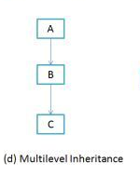
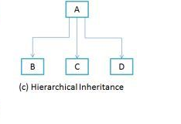
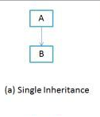
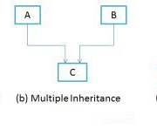
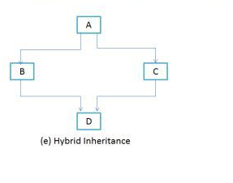
Inheritance
It’s a mechanism of consuming members of one class in another class by establishing parent/child relationship
Types of Inheritance

Slide 8
Methods Introduction
A method is an action that has to be performed.
A method can be either value returning or non-value returning also.
A value returning method will first perform an action and then returns the result of that action whereas a non-value returning method will perform an action but will not return any result of that action.
Passing parameter to a function or a method will be making that action more dynamic.

Slide 9
Variable, Object and Reference of a class
Variable- It is a copy of a class which is not initialized.
Object- It is the copy of a class that is initialized by using the new keyword which has its own memory and never shared with another instance.
Reference- It is the copy of a class that is initialized by using an existing instance. References of class will not have any memory allocation they will be sharing the same memory of the instance that assigned for initializing the variable.
Reference of a class can be called as a pointer to the instance and every modifications we perform on the members using instanve reflects when we access them through reference and vice versa.

Slide 10
THANK YOU

